Slide 2
Markdown & MkDocs
A Templating Language & Static Site generator

Slide 3
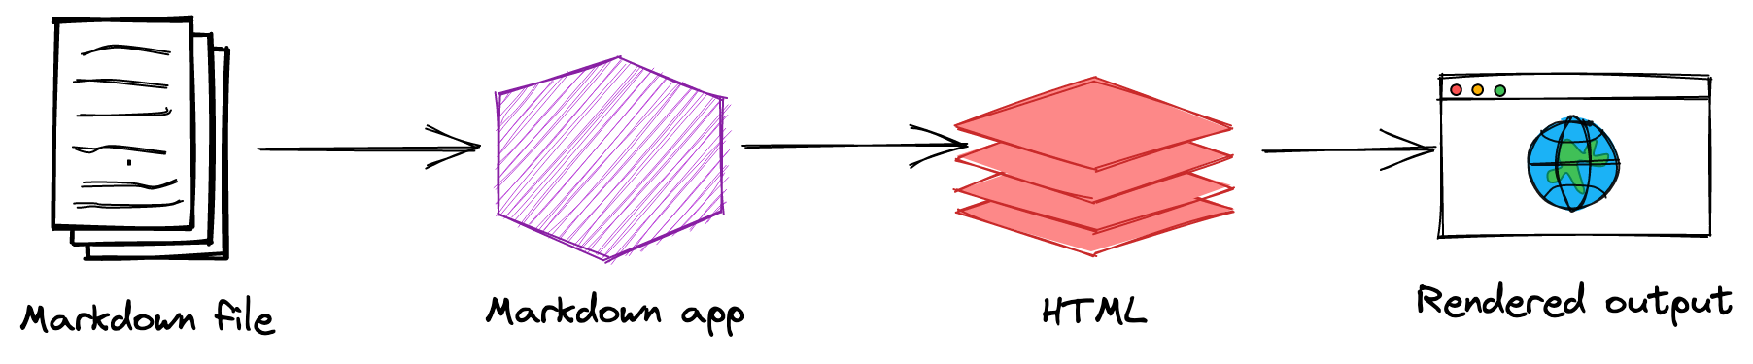
MkDocs
MkDocs is a fast, simple and downright gorgeous static site generator that's geared towards building project documentation.
Documentation source files are written in Markdown and configured with a single YAML configuration file.

Slide 4
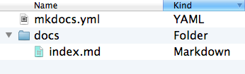
Pre-requisites & Installation
MkDocs requires a recent version of Python and the Python package manager, pip, to be installed on your system.
Steps | Commands
Install MkDocs | pip install mkdocs
Creating a MkDocs Project | mkdocs new my-project
Starting the development sever (* MkDocs comes with build in dev server) | mkdocs serve
Generated Folder Structure (MkDocs Project)
Building MkDocs | mkdocs build

Slide 5
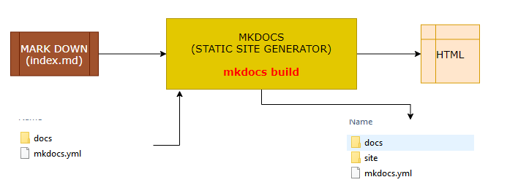
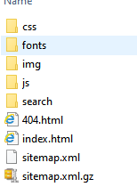
Static Site Generation & Deployment
Site Generation
This will create a new directory, named site
Deployment
The documentation site that is built only uses static files so we can be able to host it from pretty much anywhere.
Simply upload the contents of the entire site directory to wherever you're hosting your website and you're done.

Slide 6
Themes
MkDocs includes two built-in themes
mkdocs
readthedocs
Third party themes : https://github.com/mkdocs/mkdocs/wiki/MkDocs-Themes
INSTALLING AND ADDING THEMES
In-built themes can be used directly in the mkdocs.yml file.
For third party themes we need to install the theme before using it..
Every theme has they own configuration options .
For default themes configuration option refer: https://www.mkdocs.org/user-guide/choosing-your-theme/
For material theme refer : https://squidfunk.github.io/mkdocs-material/
IN-BUILT THEME (e.g readthedocs) | The theme configuration are configured in mkdocs.yml file. theme: name: readthedocs
THIRD PART THEME: EXAMPLE( IVORY THEME) (https://github.com/daizutabi/mkdocs-ivory ) | INSTALL THE THEME: pip install mkdocs-ivory USE THE THEME in mkdocs.xml theme: name: ivory

Slide 7
Writing Docs
Documentation source should be written as regular Markdown files and placed in the docs directory.
Possible Extensions of Markdown Files : markdown, mdown, mkdn, mkd, md
By default, this directory will be named docs and will exist at the top level of the project, alongside the mkdocs.yml configuration file.
ADDING NAVIGATION AND PAGES

Slide 8
Thank you !

